Slide 1
Brain Injury Guidelines (BIG)
Jeffrey Santos, MD
4.2.2026 | Department of Surgery

Slide 2
Objectives
Define BIG and modified BIG (mBIG)
Establish a framework to classify traumatic intracranial hemorrhage (ICH) using BIG
Demonstrate how BIG classification guides clinical management

Slide 3
What is BIG
  Classification system based on size/location of intracranial hemorrhage, skull fracture, concerning patient history (blood thinners, intoxication), and neurologic examination
  Three categories: BIG 1 (minor head injury), BIG 2, BIG 3 (severe head injury)
  Each category is accompanied by therapeutic recommendations based on studied patient outcomes

Slide 4
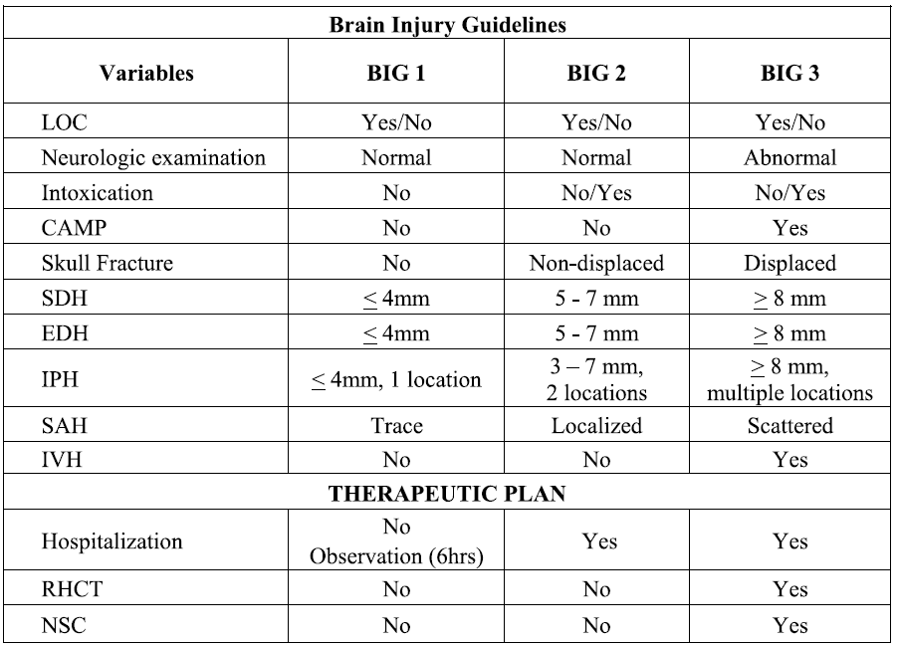

Slide 5




Safety of treatment algorithm established by evaluating progression of ICH on repeat CT head, change in neurologic status, need for neurosurgical intervention for each BIG classification

Slide 6
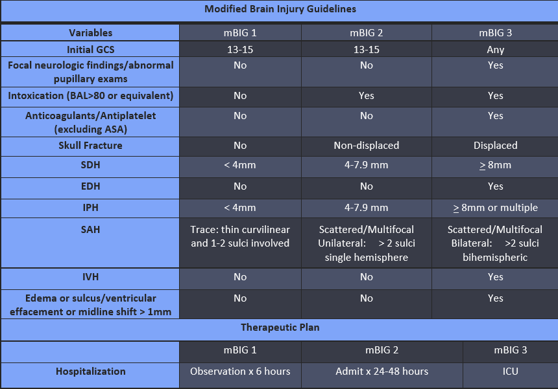
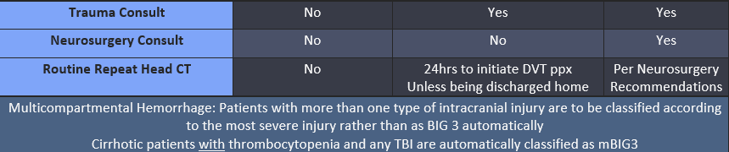
Adult patients with head trauma occurring less than 48hrs prior to presentation

Slide 7
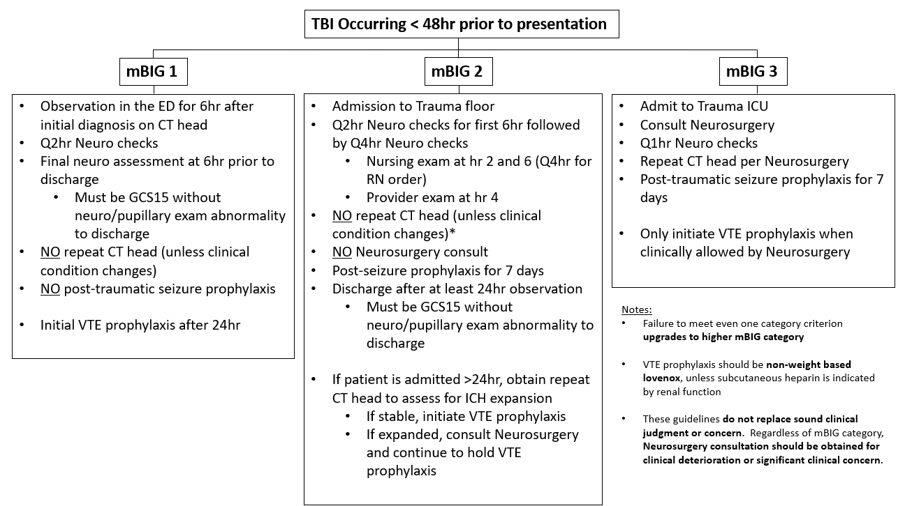

Slide 8
Key Points
BIG can be used as a common language for head injury
Established therapeutic management based on BIG category
Improved resource utilization with BIG treatment algorithm

Slide 9
Questions?
Jeffrey Santos, MD

